Slide 1
Destiny 2
Exotic Armor
BY: SEAN LI AND PETER MENDOZA

Slide 2
System Description
User:
Creates the character
Equips and finds the new armor
Bungie:
Creates the game loot and activities
Updates game information to change different aspects
Our Project is a simple updatable database, meant to store information on the current Exotic armor pieces within the game,
Destiny 2

Slide 3
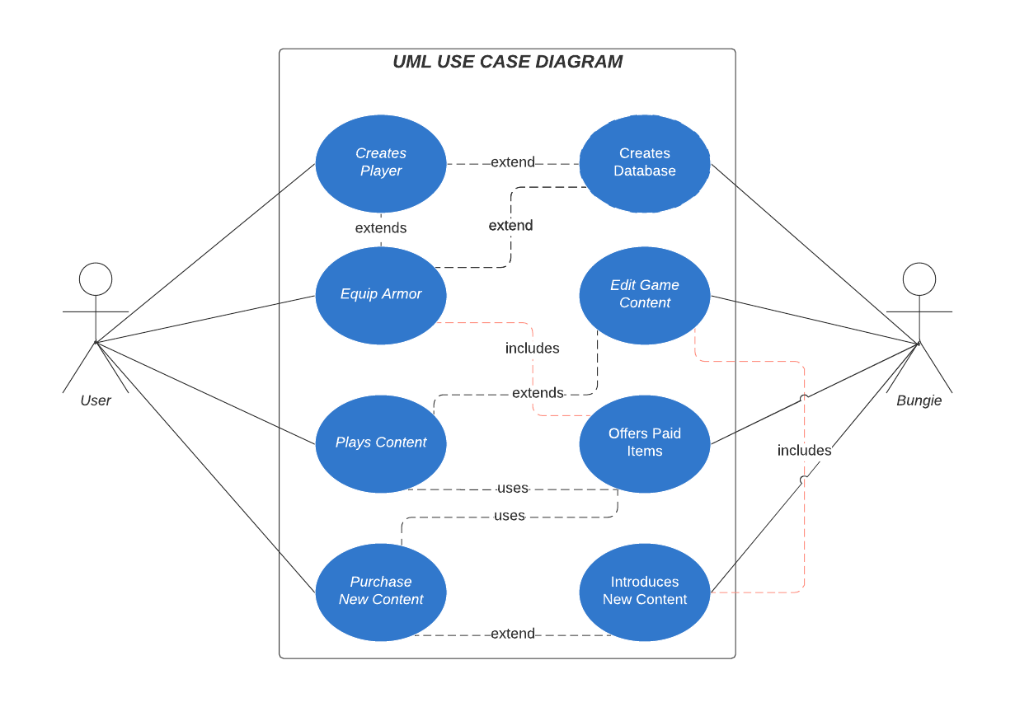
UML Diagram
Made w/ Lucidchart

Slide 4
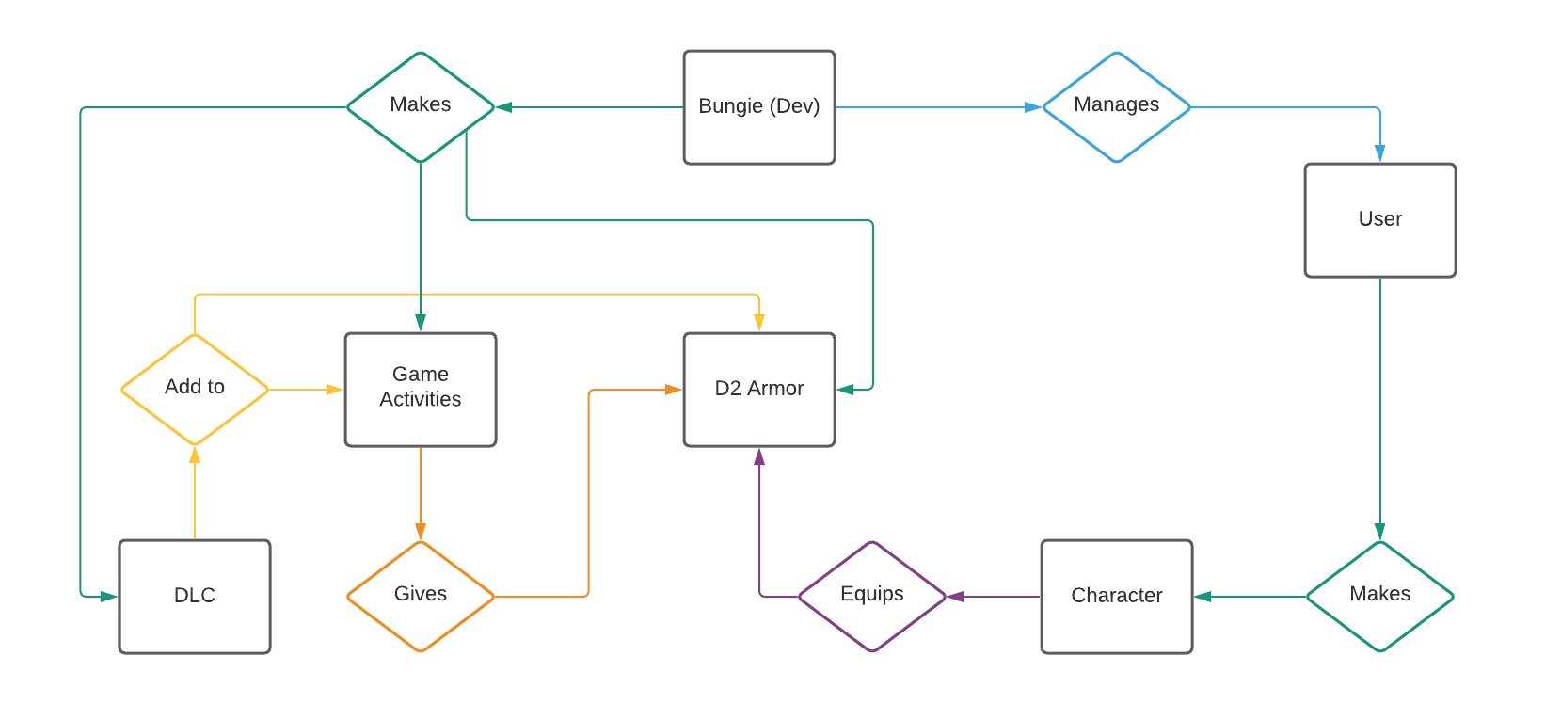
E/R Diagram

Slide 5
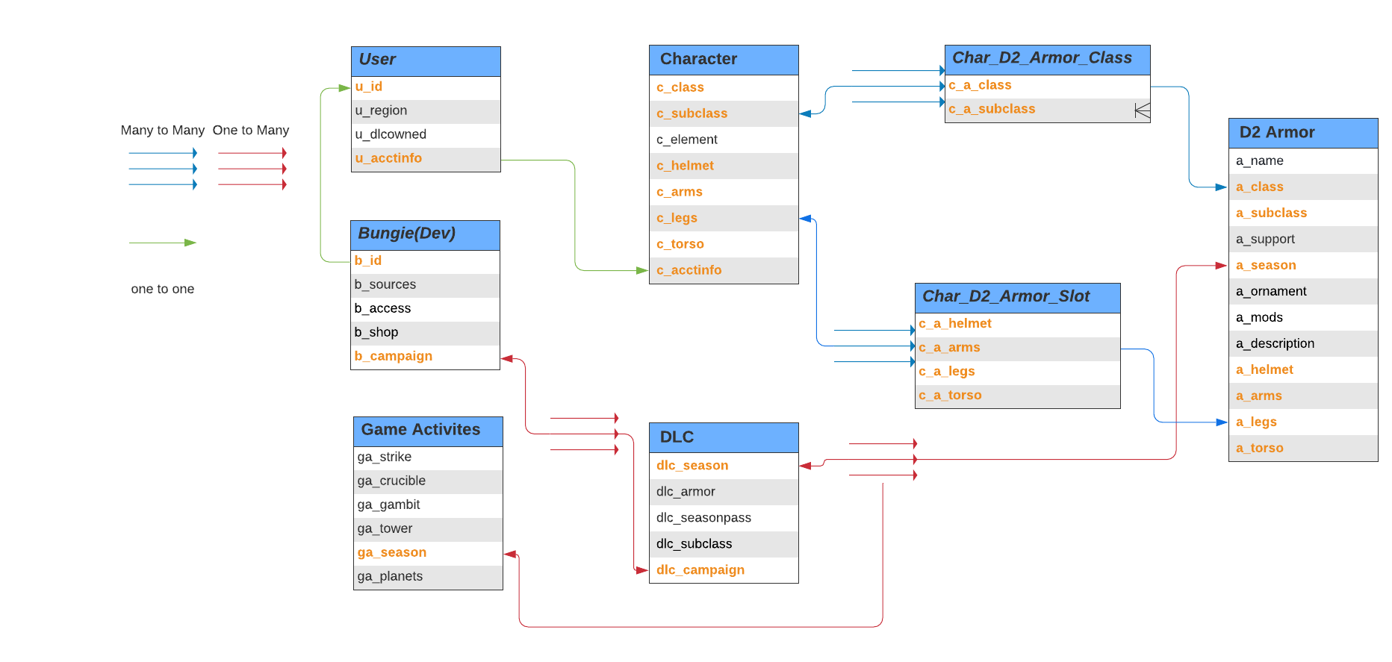
Relational Schema

Slide 6
Github Repo:
Sean02/Destiny_2_Exotic_Armor: Database Project for CSE111 - Database Systems (github.com)

Slide 7

That’s all Guardian
Notes:
https://github.com/Sean02/Destiny_2_Exotic_Armor

